Slide 1
General Purpose Input/Output (GPIO)
Jalal Kawash

Slide 2
Outline
The Raspberry Pi
Introduction to the RPi GPIO
Working with GPIO lines

Slide 3
The Raspberry Pi
Section 1

Slide 4
Section 1 Objective At the end of this section you will
Be familiar with the Raspberry Pi

Slide 5
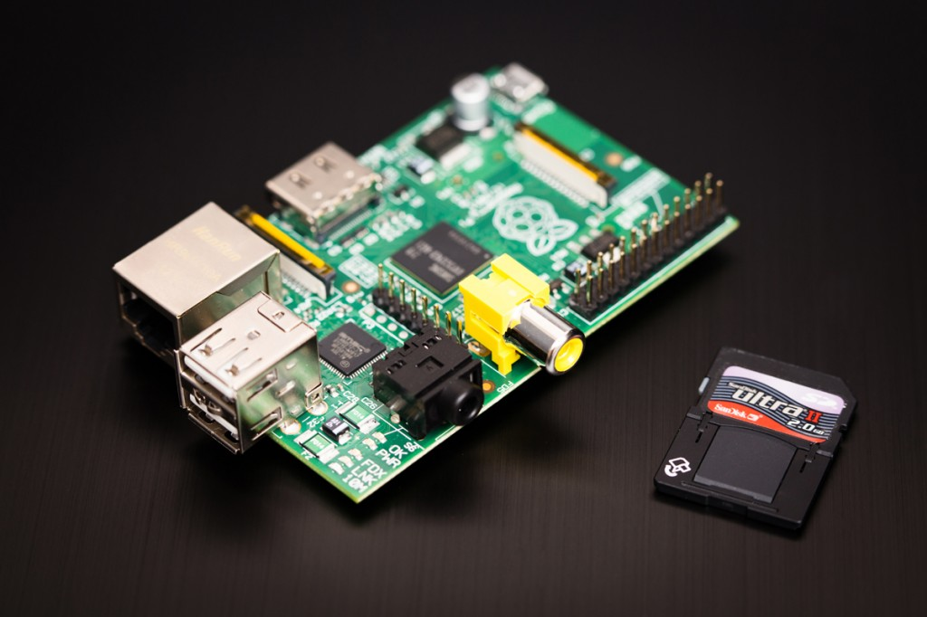

Slide 6
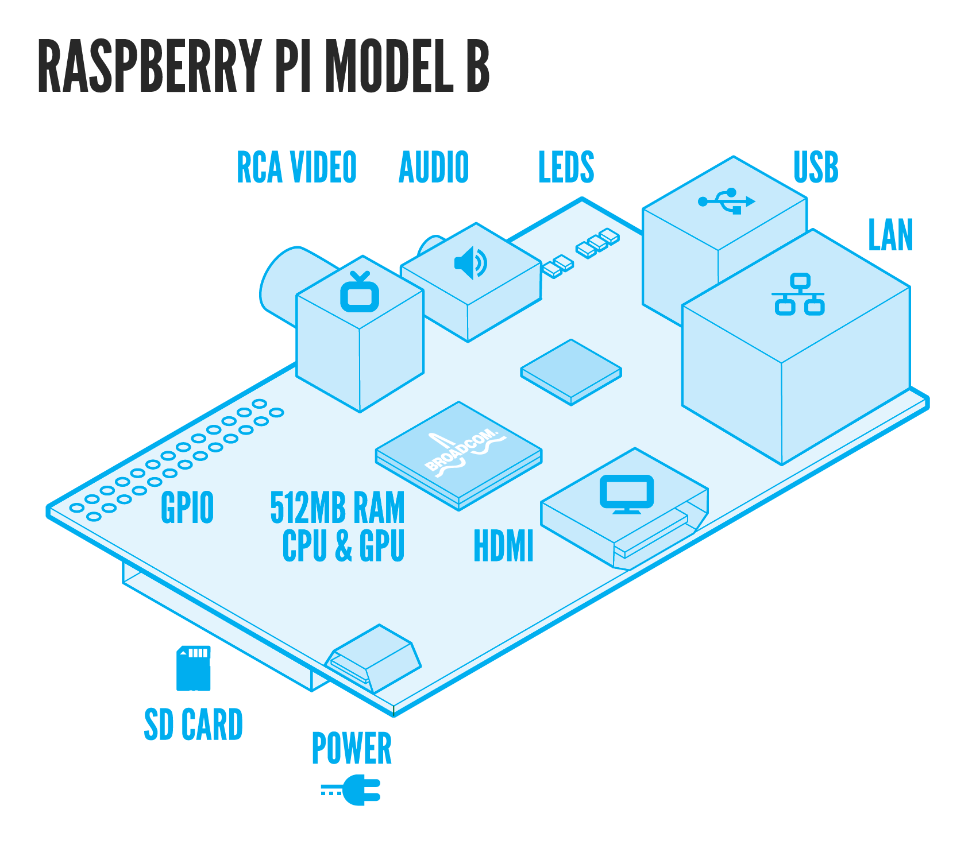
Image from raspberrypi.org

Slide 7
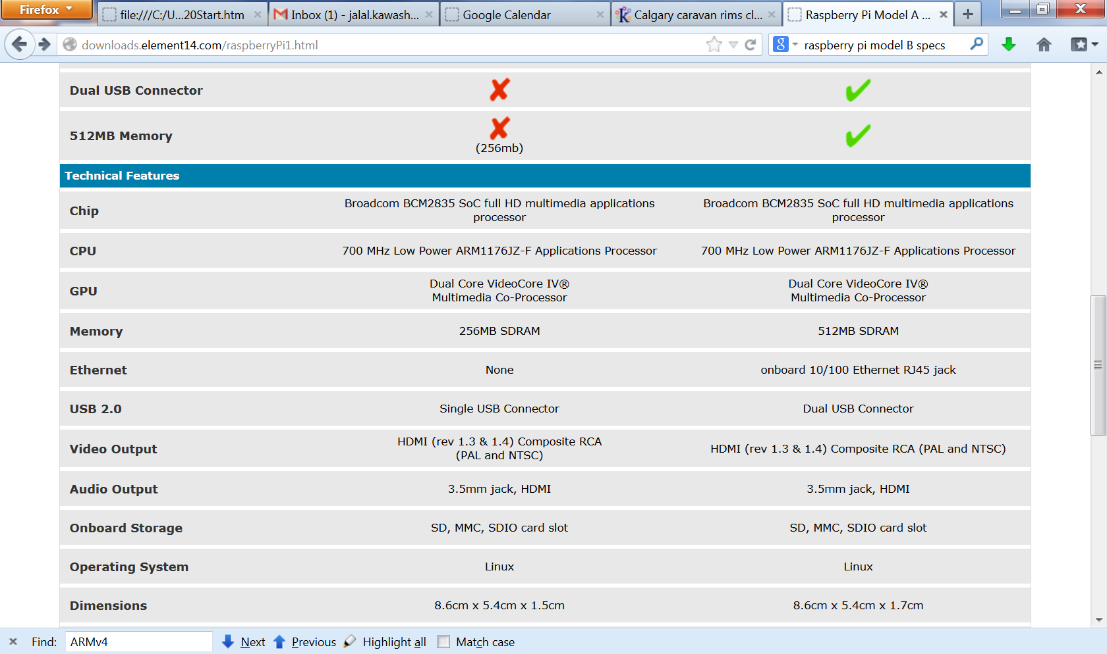
From element14.com

Slide 8
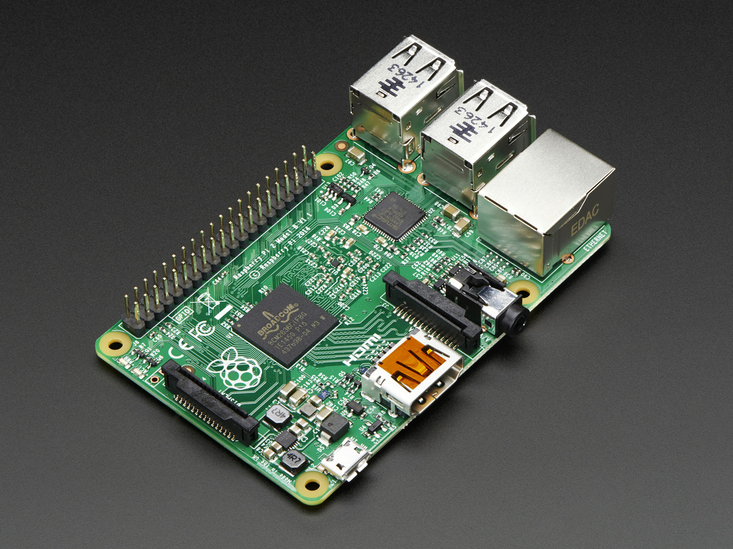
Raspberry Pi 2

Slide 9
Technical Specs
900 MHz ARMv7 Quad Core Processor (Cortex-A7)
1GB RAM
40 pin extended GPIO
4 x USB 2 ports
CSI camera port (Raspberry Pi camera)
DSI display port (Raspberry Pi touch screen)
From element14.com

Slide 10
Introduction to the Raspberry Pi GPIO
Section 2

Slide 11
Section 2 Objectives At the end of this section you will
Get a quick look at the RPi GPIO pins
Look at example uses of the GPIO

Slide 12
GPIO
General Purpose Input/Output device
Famous with microcontrollers
Provide extended functions without changing circuitry
Has 54 lines
Only a subset is available for the RPi
26 lines in Pi1
40 lines in Pi2

Slide 13
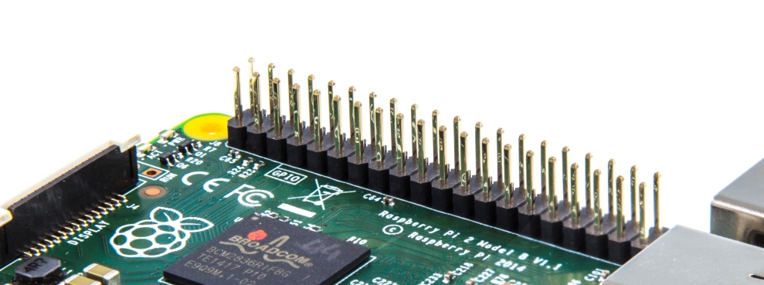
RPi GPIO
Programmable
40 header pins on the RPi
Provide UART and 5V power
Provide others too e.g. CSI (camera serial interface) and DSI (Display serial interface)
Not plug and play

Slide 14
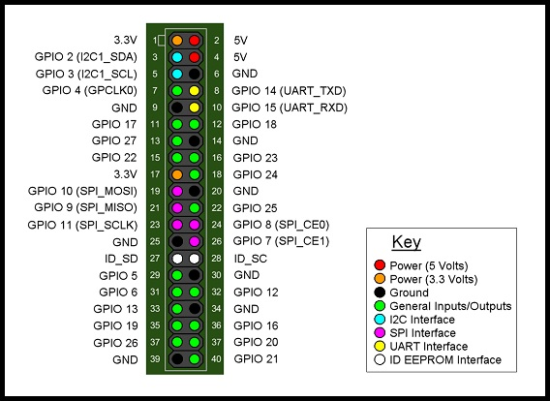
www.ebay.com

Slide 15
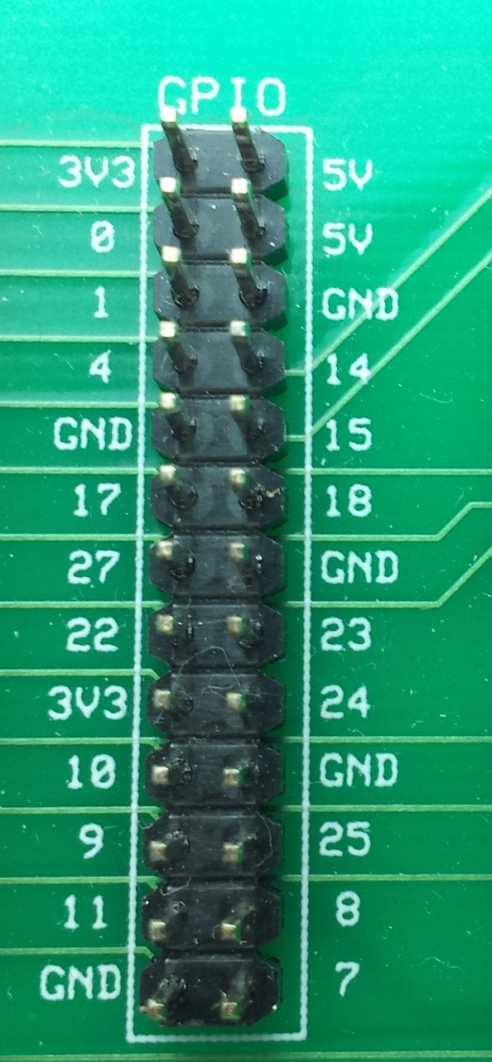

Slide 16
ebay.com

Slide 17
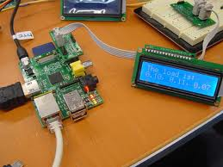
Example Uses
Image from: www.raspberrypi.org

Slide 18
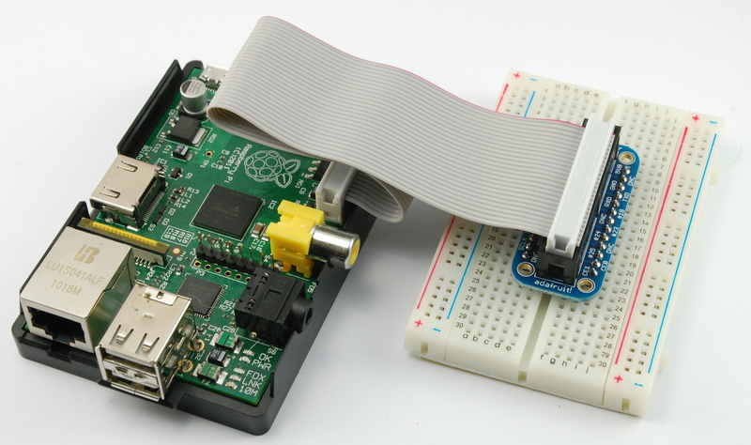
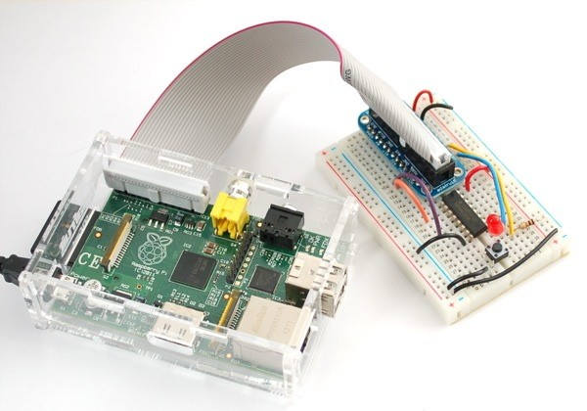
Example Uses
Images from: learn.adafruit.com & kiwi.psnc.pl

Slide 19
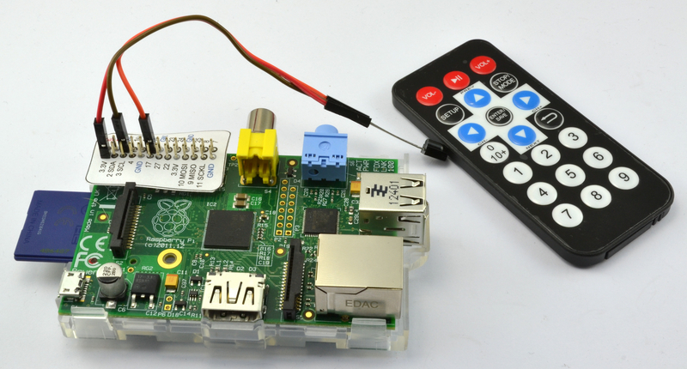
Example Uses
Image from: learn.adafruit.com

Slide 20
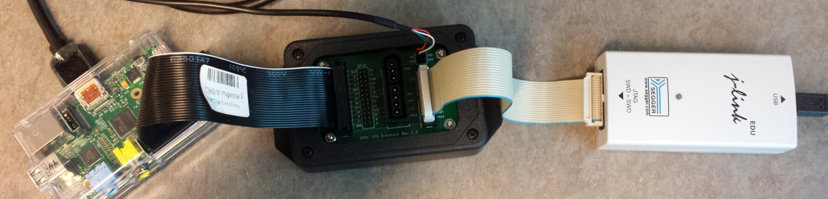
Example Uses

Slide 21
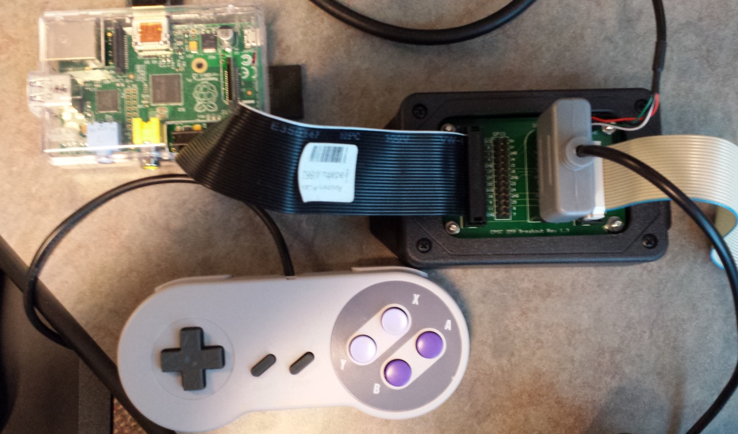
Example Uses

Slide 22
Working with GPIO Lines
Section 3

Slide 23
Section 3 Objectives At the end of this section you will
Have a closer look at GPIO registers
Know how to set functions to GPIO pins
Know how to use the pins for input and output

Slide 24
RPi GPIO pins
The RPi GPIO has 16 GP pins
Green ones
Since they are not plug-and-play, some work is need to initialize, write, and read
Each of these pins can have up to 6 functions
For example function 1 is write & 0 is read
From core’s point of view

Slide 25
Pseudo Memory Mapped Registers
A memory-mapped register is dealt with as a memory address
It is accessed by LDR & STR
A pseudo memory-mapped register is an actual peripheral register that is accessed as a memory location
MMU deals with these requests
MMU sends the request to the device rather than memory

Slide 26
Pseudo Memory Mapped Registers
LDR r0, =0x3F200000
LDR r1, [r0]
Program
Register 0x3F200000
Address 0x3F200000 is a peripheral register
MMU
LDR
LDR
Regular Loads
RAM
GPIO registers are
pseudo
memory-mapped

Slide 27
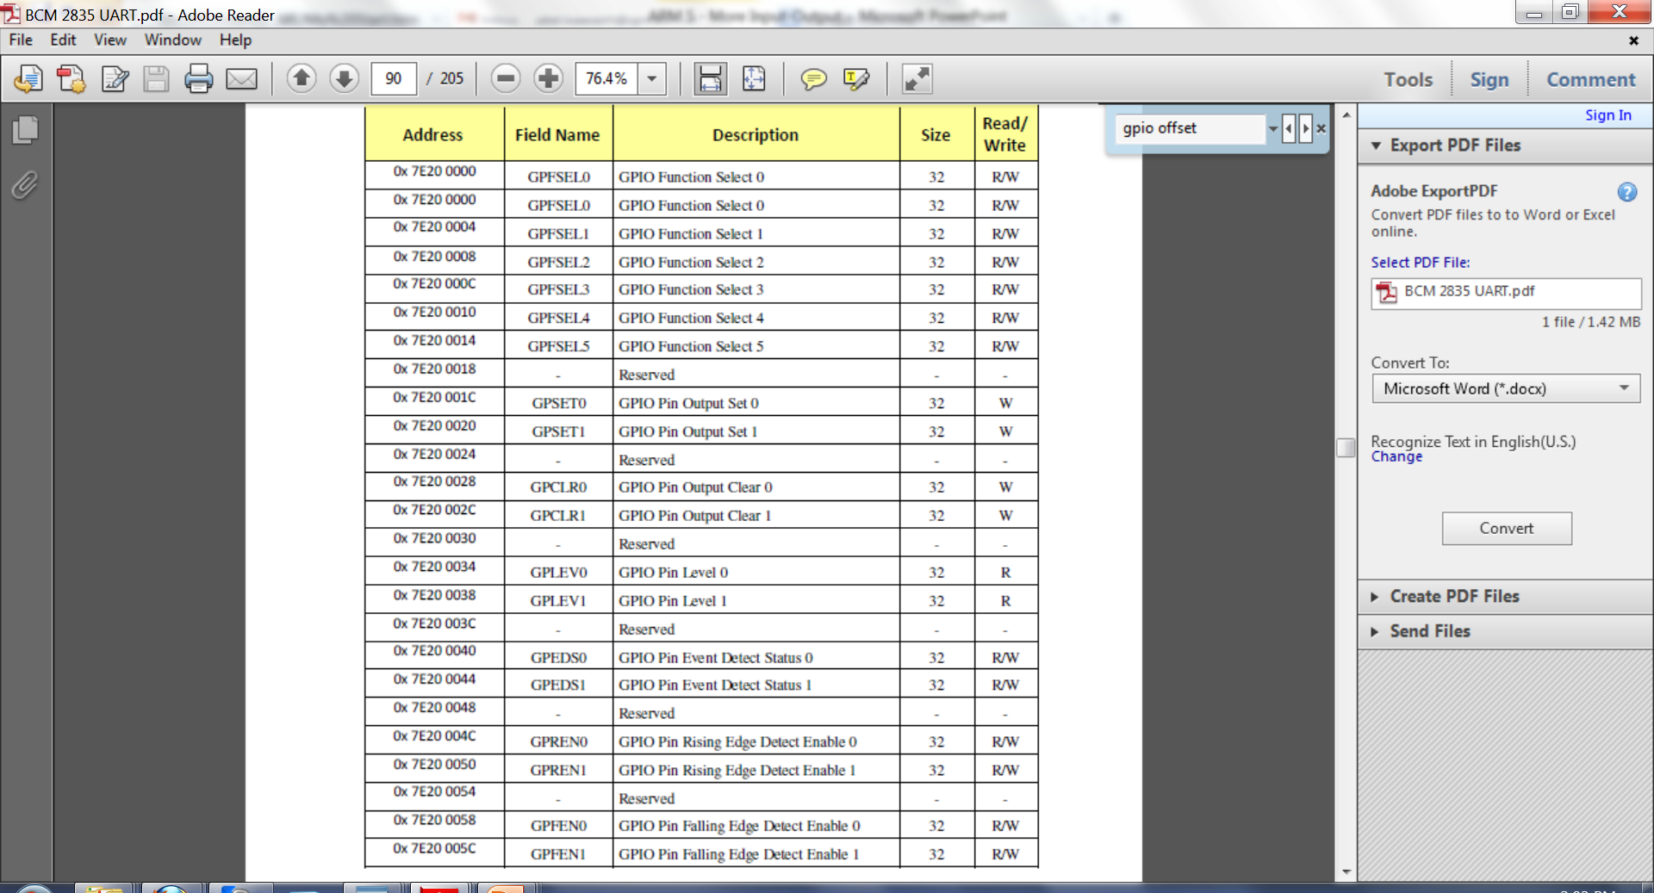
GPIO Registers
Function
Select
Set
(Write 1)
Clear
(Write 0)
Level
(Read)
More info refer to: BCM2835 ARM Peripherals (available on BB)

Slide 28
GPIO Registers
There are more registers
Refer to: BCM2835 ARM Peripherals (available on BB) for more info
This document lists virtual addresses (in Linux) for registers
Replace 7E in the virtual address by 3F to obtain the physical address

Slide 29
Function Select Registers
GPFSEL5
0x3F200014
For pins 50 to 53
GPFSEL4
0x3F200010
For pins 40 to 49
GPFSEL3
0x3F20000c
For pins 30 to 39
GPFSEL2
0x3F200008
For pins 20 to 29
GPFSEL1
0x3F200004
For pins 10 to 19
GPFSEL0
0x3F200000
For pins 0 to 9
Base GPIO address

Slide 30
Accessing GPIO Registers
GPIO uses “pseudo” memory-mapped I/O
Accessed as if accessing memory locations
unsigned int *gpio = 0x3F200000;
#define GPFSEL0 0
…
unsigned int v;
…
v = gpio[GPFSEL0];
gpio[GPFEL0] = v;

Slide 31
Pin Offset from GPIO Base Address
A register corresponds to many GPIO pins
For example
Each pin (0 to 9) is controlled by 3 bits in GPFSEL0
For example, bits 0-2 set the function for GPIO pin 0
Each pin can be given a function (from up to 6 functions)
In our case, it is mostly input or output functions
GPFSEL0
For pins 0 to 9

Slide 32
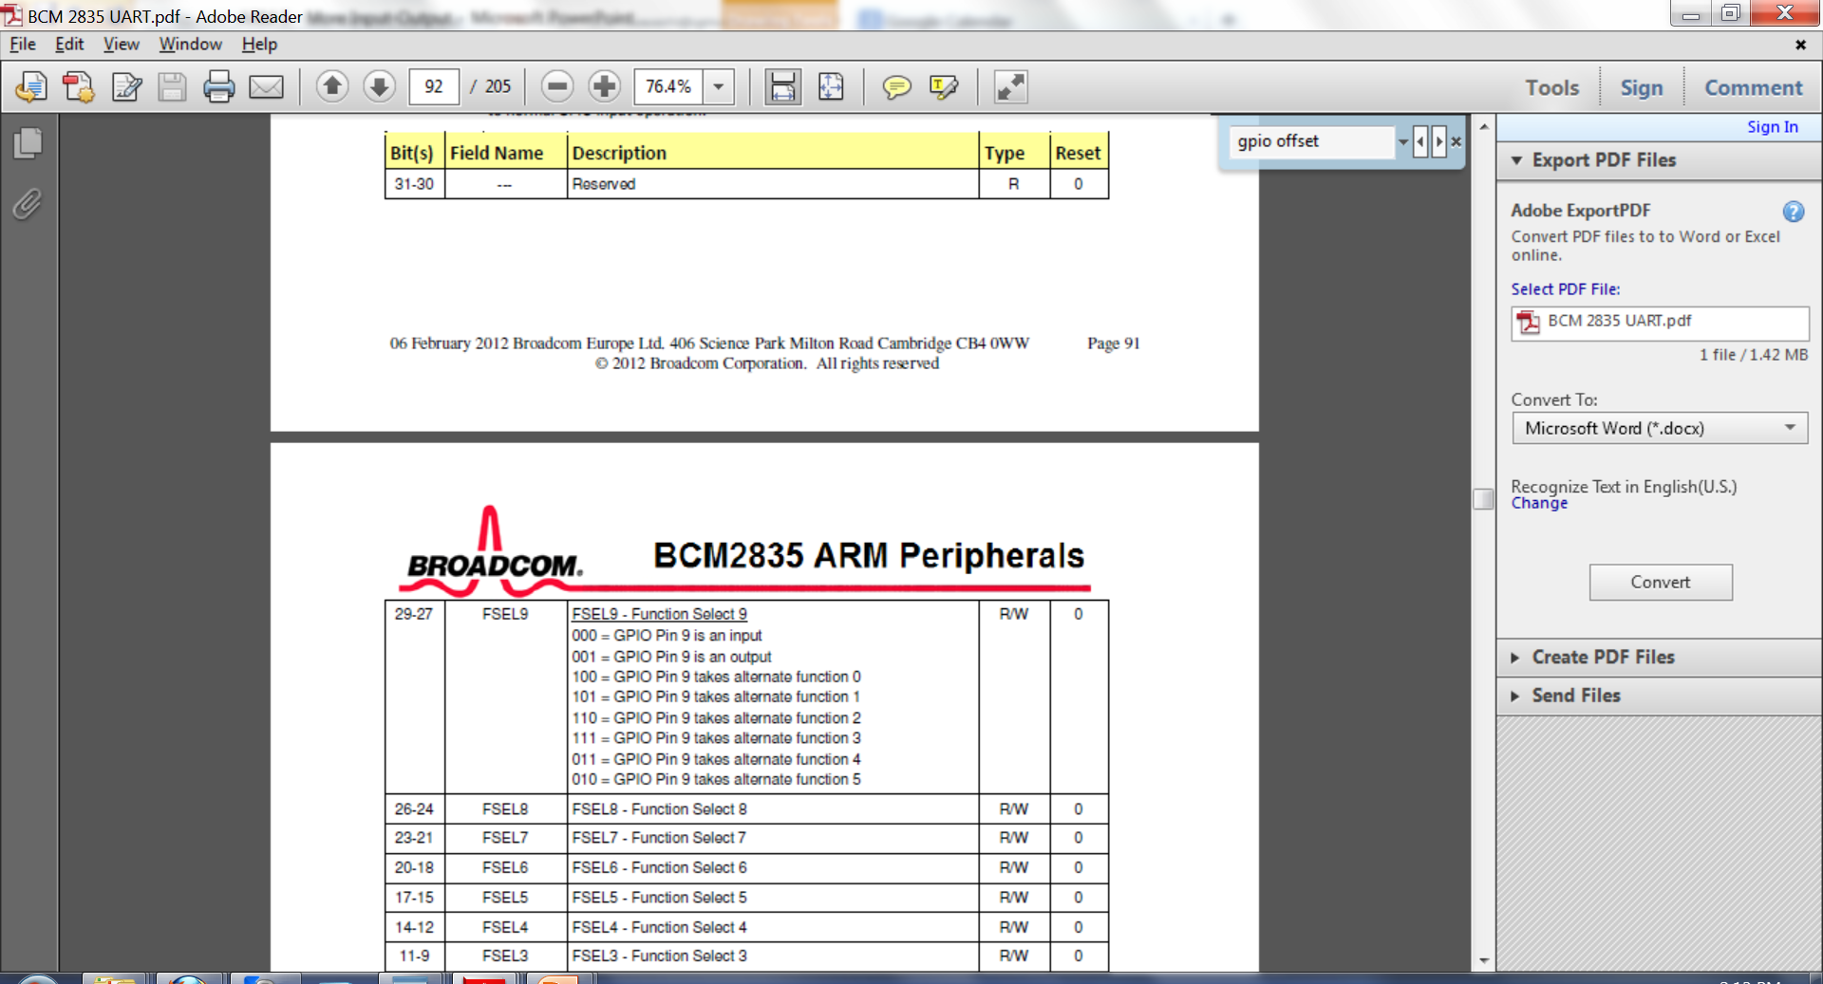
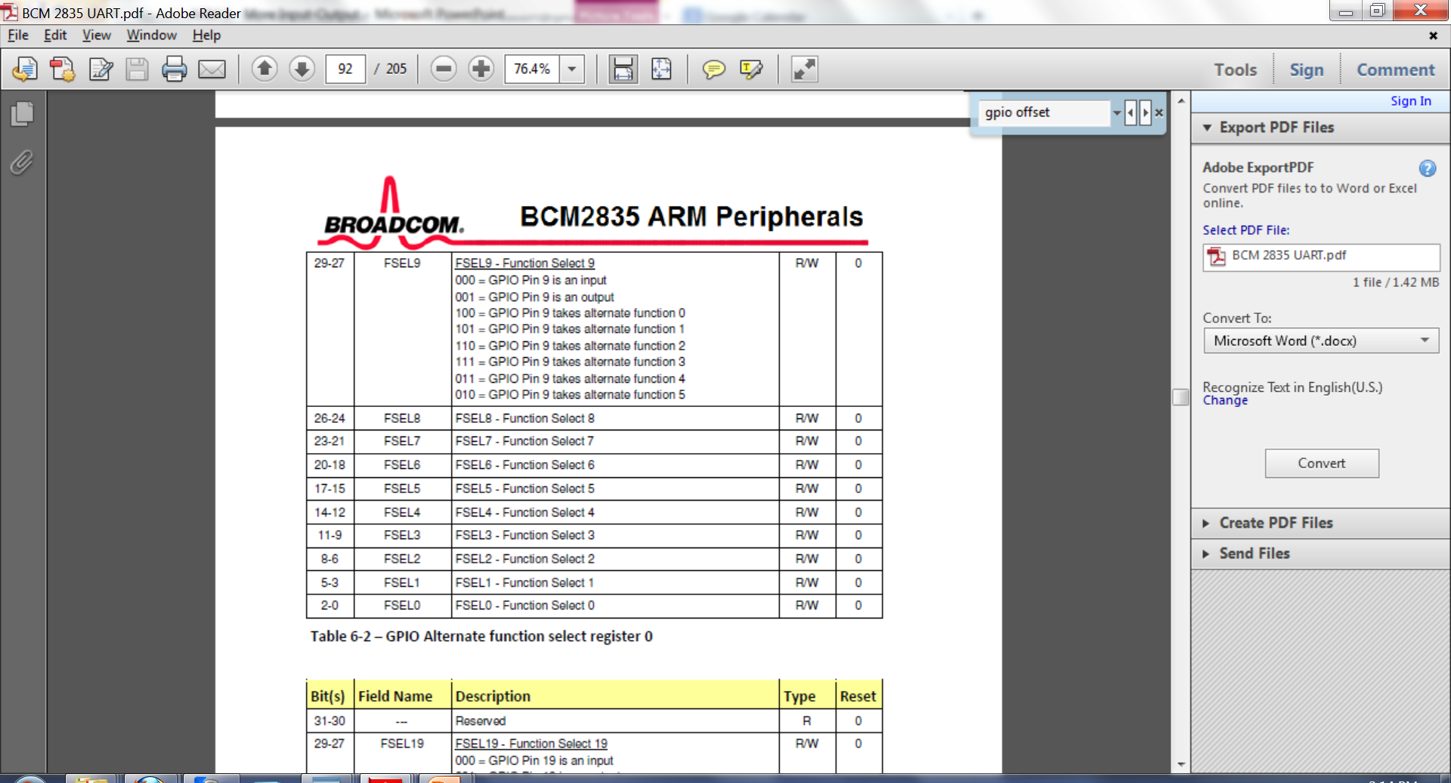
Inside GPFSEL0
From: BCM2835 ARM Peripherals

Slide 33
Calculating the Pin Offset
If pin# is single-digit
Offset = address for GPFSEL0 (base GPIO address, 0x3F200000)
If pin# > 9 (more than one digit)
Offset = base GPIO address + 4*(pin# div 10)
Address of GPFSEL1 to GPFSEL5
Example (pins 10 to 19):
Offset = 0x3F200000 + 4*(1) = 0x3F200004
Which is address for GPFSEL1

Slide 34
Getting to Appropriate Pins
Given some pin#
Let GPFSEL{n} be the register that controls this pin#
n = pin# div 10
Let d be the least significant digit of pin#
The 3 bits of GPFSEL{n} that select pin#’s function start at d*3
GPIOFSEL{n}
30-31
27-29
24-26
21-23
18-20
15-17
12-14
9-11
6-8
3-5
0-2
reserved
Pin
{n}9
Pin
{n}8
Pin
{n}7
Pin
{n}6
Pin
{n}5
Pin
{n}4
Pin
{n}3
Pin
{n}2
Pin
{n}1
Pin
{n}0

Slide 35
GPFSEL registers
GPFSEL0
31
30
29
28
27
26
25
24
23
22
21
20
19
18
17
16
15
14
13
12
11
10
9
8
7
6
5
4
3
2
1
0
rsrvd
pin 9
pin 8
pin 7
pin 6
pin 5
pin 4
pin 3
pin 2
pin 1
pin 0
GPFSEL1
31
30
29
28
27
26
25
24
23
22
21
20
19
18
17
16
15
14
13
12
11
10
9
8
7
6
5
4
3
2
1
0
rsrvd
pin 19
pin 18
pin 17
pin 16
pin 15
pin 14
pin 13
pin 12
pin 11
pin 10
GPFSELn (n ∈ {0 .. 5})
31
30
29
28
27
26
25
24
23
22
21
20
19
18
17
16
15
14
13
12
11
10
9
8
7
6
5
4
3
2
1
0
rsrvd
pin n9
pin n8
pin n7
pin n6
pin n5
pin n4
pin n3
pin n2
pin n1
pin n0

Slide 36
Example
Pin 32
Register GPFSEL3, offset 0x3F20000c
= 4*(32 div 10) + 0x3F200000
Least significant bit of pin# is 2
The three bits of GPFSEL3 that control pin 32 start at bit 3*2 = 6
Hence, bits 6-8 define the function of pin 32

Slide 37
Setting the bits in GPFSEL{n}
Clear the appropriate bits in GPFSEL{n}
Set the appropriate bits in GPSFEL{n}

Slide 38
Resetting the bits for pin 3
Reset GPFSEL0[9..11] to 000
AND GPFSEL0 with 1..1 000 111 111 111
~(7<<(((p)%10)*3))
b0111 << (3%10)* 3
b0111 << 9
shift left 9 bits
0..0 111 000 000 000
~(0..0 111 000 000 000)
1..1 000 111 111 111

Slide 39
Resetting the bits for pin 3
#define GPIO_BASE 0x3F200000 // Address for GPIOFSEL0
unsigned *gpio = (unsigned*)GPIO_BASE; // GPIO base
*(gpio+((p)/10)) &= ~(7<<(((p)%10)*3))
Bitwise AND [0x3F200000] with 1..1 000 111 111 111
Pin 3 is an input pin now

Slide 40
Clearing pin 3 bits (Input pin)
pin 3
pin 2
pin 1
pin 0
GPFSEL0=
?..?
?
?
?
?
?
?
?
?
?
?
?
?
7=
0..0
0
0
0
0
0
0
0
0
0
1
1
1
7<<9=
0..0
1
1
1
0
0
0
0
0
0
0
0
0
~(7<<9)=
1..1
0
0
0
1
1
1
1
1
1
1
1
1
pin 3
pin 2
pin 1
pin 0
GPFSEL0=
?..?
?
?
?
?
?
?
?
?
?
?
?
?
~(7<<9)=
1..1
0
0
0
1
1
1
1
1
1
1
1
1
&
(AND)
pin 3
pin 2
pin 1
pin 0
GPFSEL0=
?..?
0
0
0
?
?
?
?
?
?
?
?
?

Slide 41
Resetting the bits for pin p
#define GPIO_BASE 0x3F200000 // Address for GPIOFSEL0
unsigned *gpio = (unsigned*)GPIO_BASE; // GPIO base
#define INP_GPIO(p) *(gpio+((p)/10)) &= ~(7<<(((p)%10)*3))

Slide 42
Setting the bits for pin 3
Reset pin 3 (INP_GPIO(3))
*(gpio+((3)/10)) |= (1<<(((3)%10)*3))
(1<<(((3)%10)*3))
(1<<9)
0..0 001 000 000 000
Bitwise OR [0x3F200000] with 0..0 001 000 000 000
Pin 3 is an output pin now

Slide 43
Example – Setting pin 3 bits
pin 3
pin 2
pin 1
pin 0
GPFSEL0=
?..?
0
0
0
?
?
?
?
?
?
?
?
?
1=
0..0
0
0
0
0
0
0
0
0
0
0
0
1
1<<9=
0..0
0
0
1
0
0
0
0
0
0
0
0
0
pin 3
pin 2
pin 1
pin 0
?..?
0
0
0
?
?
?
?
?
?
?
?
?
0..0
0
0
1
0
0
0
0
0
0
0
0
0
|
OR
pin 3
pin 2
pin 1
pin 0
GPFSEL0=
?..?
0
0
1
?
?
?
?
?
?
?
?
?

Slide 44
Setting the bits for pin p
#define GPIO_BASE 0x3F200000 // Address for GPIOFSEL0
unsigned *gpio = (unsigned*)GPIO_BASE; // GPIO base
#define OUT_GPIO(p) *(gpio+((p)/10)) |= (1<<(((p)%10)*3))

Slide 45
Reading and Writing Pins

Slide 46
Performing I/O
Once a pin function is set, then pin can be used for I/O
To write to a pin, use GPSET{0,1} or GPCLR{0,1}
To read from a pin, use GPLEV{0,1}

Slide 47
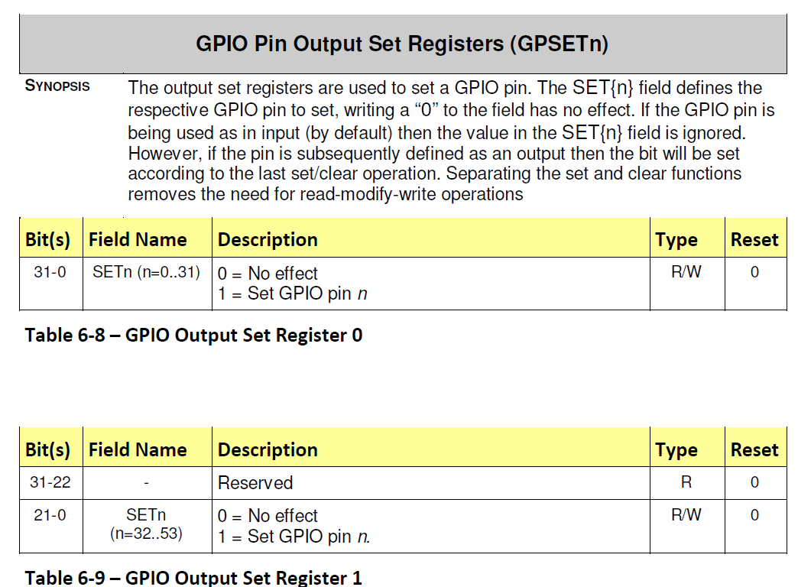
Dividing a pin# by 32 determines which register must be used
From: BCM2835 ARM Peripherals

Slide 48
GPSET0 register
GPSET0
GPSET0
0
0
pin 0
1
1
pin 1
2
2
pin 2
3
3
4
4
5
5
pin 5
…
…
31
31
pin 31

Slide 49
GPSET1 register
Not used on the Pi
GPSET1
GPSET1
0
0
pin 32
1
1
pin 33
2
2
pin 34
3
3
4
4
5
5
pin 37
…
…
31
21
pin 53
reserved

Slide 50
GPSET0 Address
Base GPIO Address : 0x3F200000
GPSET0 : Base + 28 = 0x3F20001C
28 decimal is 0x1C

Slide 51
Setting (writing 1 to) a pin
GPSET0
GPSET0
0
0
0
0
1
0
1
0
2
0
0
No effect on pin 2
2
3
0
1
Write 1 to pin 3
3
…
…
31
0
0
31

Slide 52
Setting (Writing to) a Pin
If writing 1, then use GPSET{n}, n= 0,1
gpioAddr + 28 + {4*n}
28 and 4*n are decimal values
If writing 0, use GPCLR{n}
A write of 0 to GPSET{n} is ignored
gpioAddr + 40 + {4*n}
40 and 4*n are decimal values

Slide 53
GPCLR0 register
GPCLR0
GPCLR0
0
0
pin 0
1
1
pin 1
2
2
pin 2
3
3
4
4
5
5
pin 5
…
…
31
31
pin 31

Slide 54
Clearing (writing 0 to) a pin
GPCLR0
GPCLR0
0
0
0
0
1
0
1
0
2
0
0
No effect on pin 2
2
3
0
1
Write 0 to pin 3
3
…
…
31
0
0
31

Slide 55
Example
To write 1 to (set) pin 3:
GPSET[3] = 1
To write 0 to (clear) pin 3:
GPCLR[3] = 1
GPSET[i] = 0 and GPCLR[i] =0 have no effect on pin

Slide 56
Writing to pins 0 – 31
unsigned int *gpio = 0x3F200000;
#define GPSET0 7 \\ 28/4
#define GPCLR0 10 \\ 40/4
...
if (writing 1)
gpio[GPSET0] = 1 << pinNumber;
else
gpio[GPCLR0] = 1 << pinNumber;

Slide 57
GPCLR1
Used to clear the remaining pins
Pins 32 to 53
Bit 0 clears pin 32, …
Not used on the Pi

Slide 58
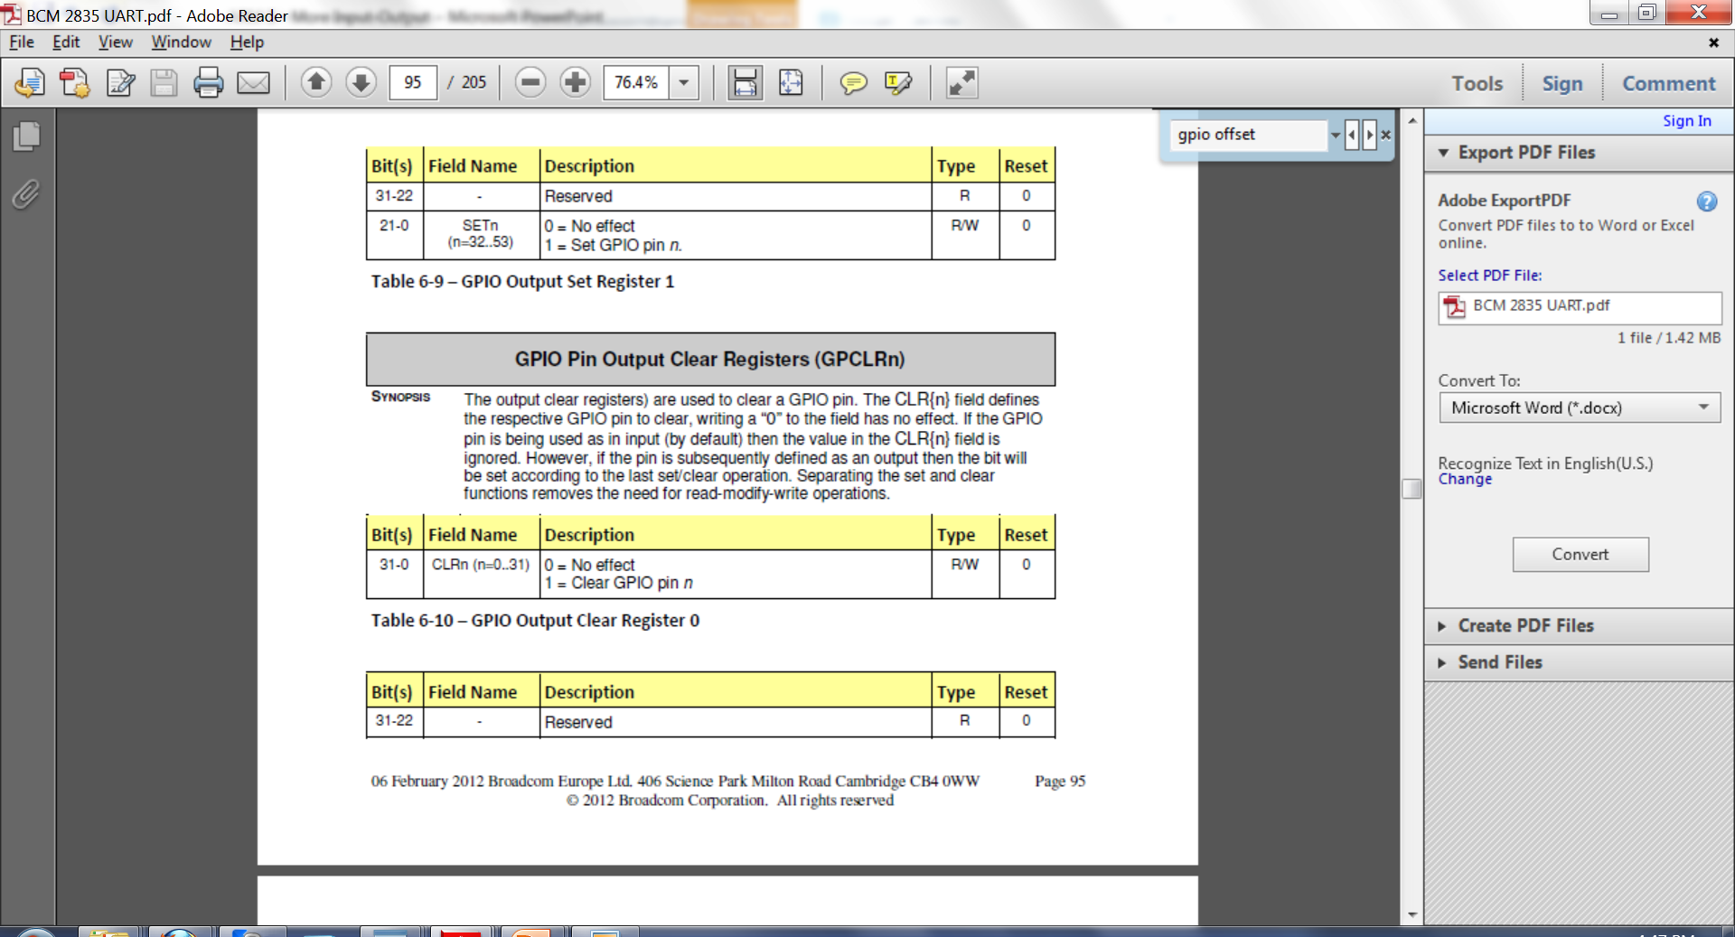
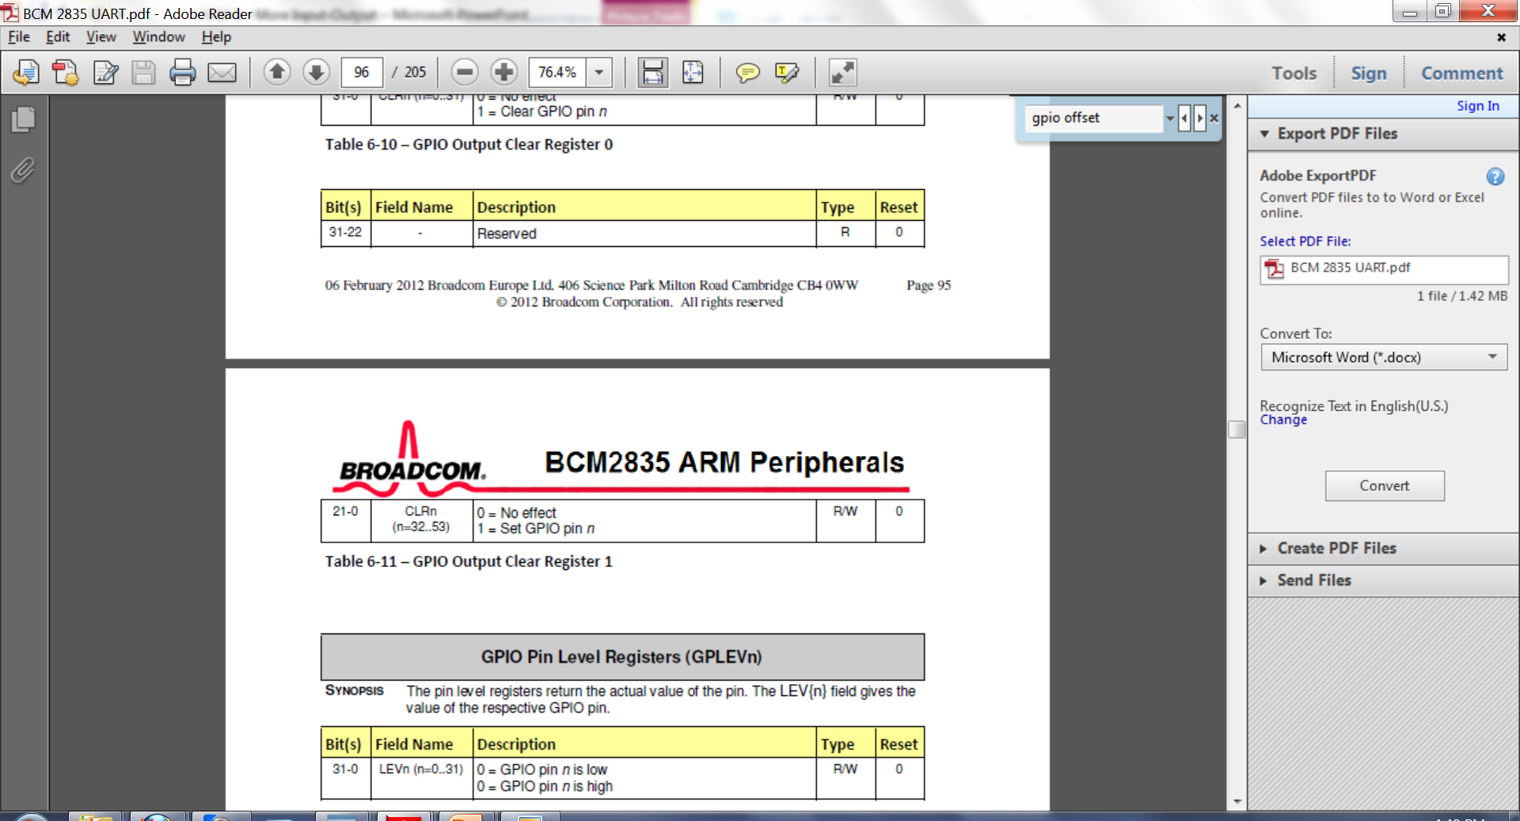
X
Clear
From: BCM2835 ARM Peripherals

Slide 59
GPCLR0 Address
Base GPIO Address : 0x3F200000
GPCLR0 : Base + 40 = 0x3F200028

Slide 60
Reading a Pin
Register GPLEVn is used to read a bit from a pin
In the RPi, only GPLEV0 is used
Bit n corresponds to the value of pin n
Address of GPLEV0 is ox3F200000 + 52
0x3F200034

Slide 61
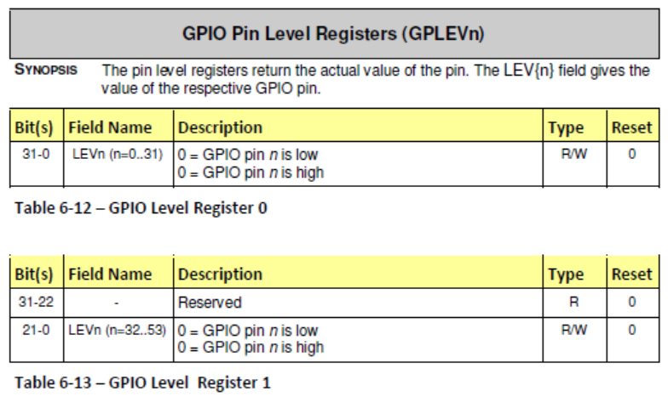
Inside GPLEV{n}
From: BCM2835 ARM Peripherals

Slide 62
GPLEV0 register
GPLEV0
GPLEV0
0
0
pin 0
1
1
pin 1
2
2
pin 2
3
3
4
4
5
5
pin 5
…
…
31
31
pin 31

Slide 63
GPLEVn Addresses
Base GPIO Address : 0x3F200000
GPLEV0 : Base + 52 = 0x3F200034
GPLEV1 : Base + 60 = 0x3F20003C
Not used in the Pi

Slide 64
Reading from pins 0 – 31
unsigned int *gpio = 0x3F200000;
#define GPLEV0 13
...
int v;
v = (gpio[GPLEV0] >> 3) & 1;
// v = pin 3 value

Slide 65
Other GPIO functions
Clock signal
UART
JTAG
Etc …

Slide 66
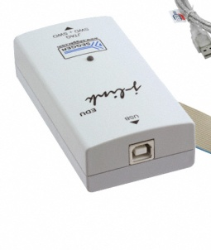
JTAG Interface
Joint Test Action Group
IEEE 1149.1 Standard Test Access Port and Boundary-Scan Architecture
Originally used for IC debug ports
Embedded system development relies on JTAG to perform debugging
ARM11 has an extensive JTAG capability
EnableJTAG routine in jtag.s (by Dmitry Zavyalov)

Slide 67
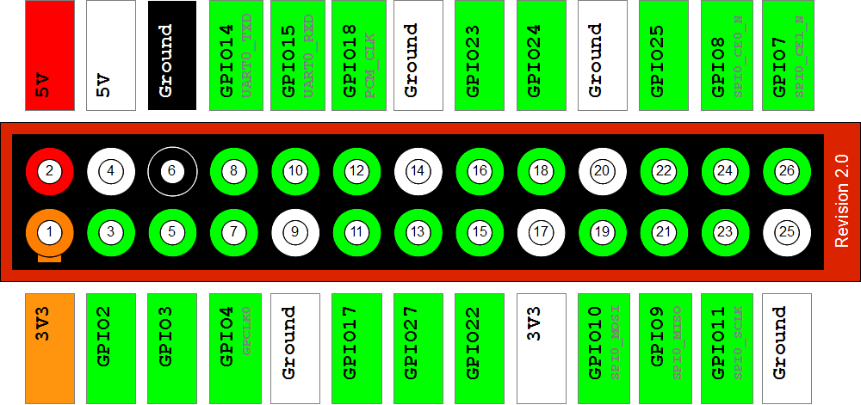
JTAG Interface Pins
www.raspberrypi-spy.co.uk

Slide 68
ebay.com

